Slide 1
Quantization
Linear quantization

Slide 2
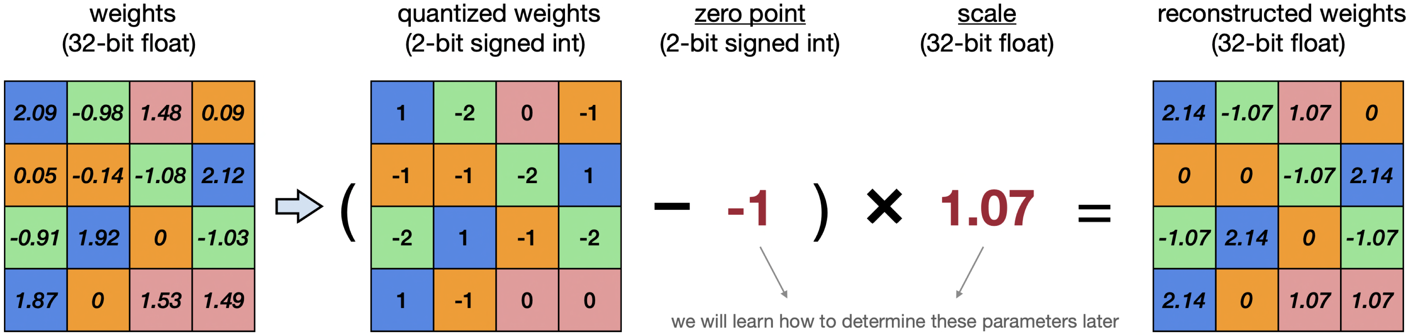
Quantization
Linear quantization
An affine mapping of integers to real floating-point numbers, follow the formula:
r = S(q - Z)
where:
r: raw floating-point number (fp32)
S: scale (fp32)
z: zero-point (uint8/int32)
=> Lossy compression

Slide 3
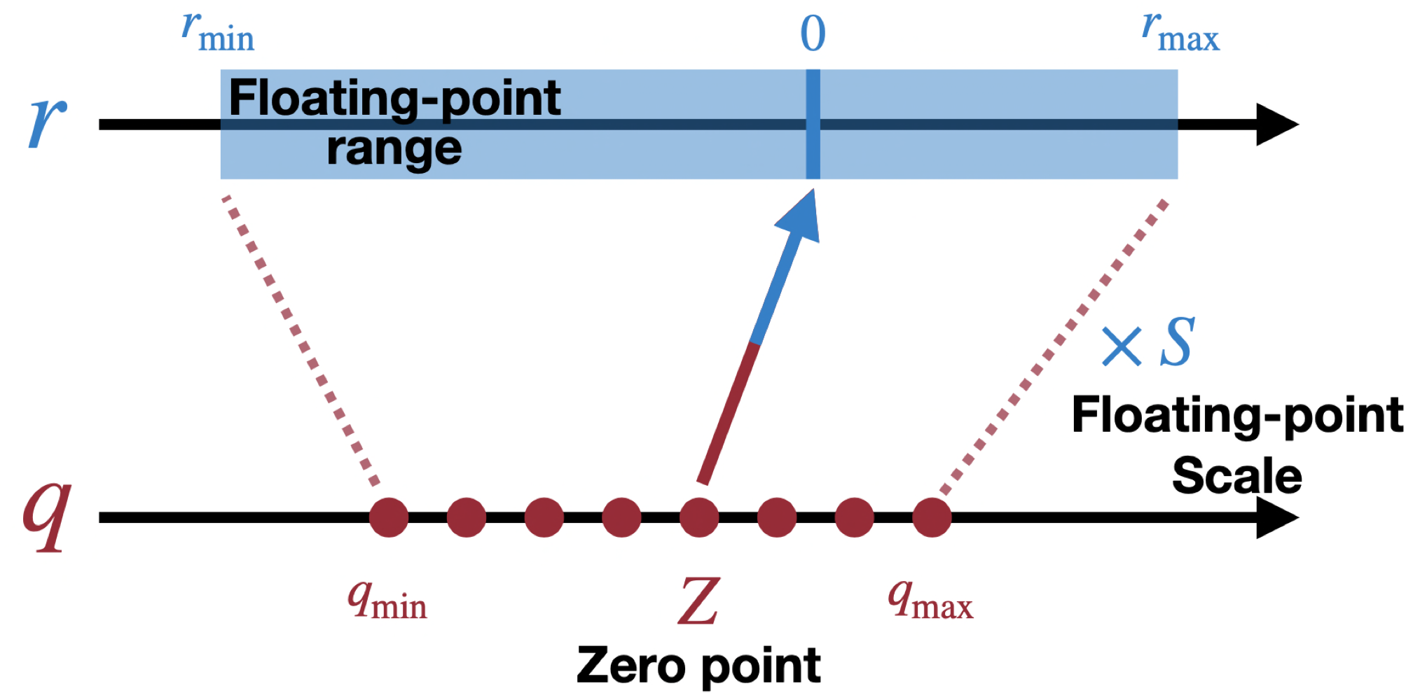
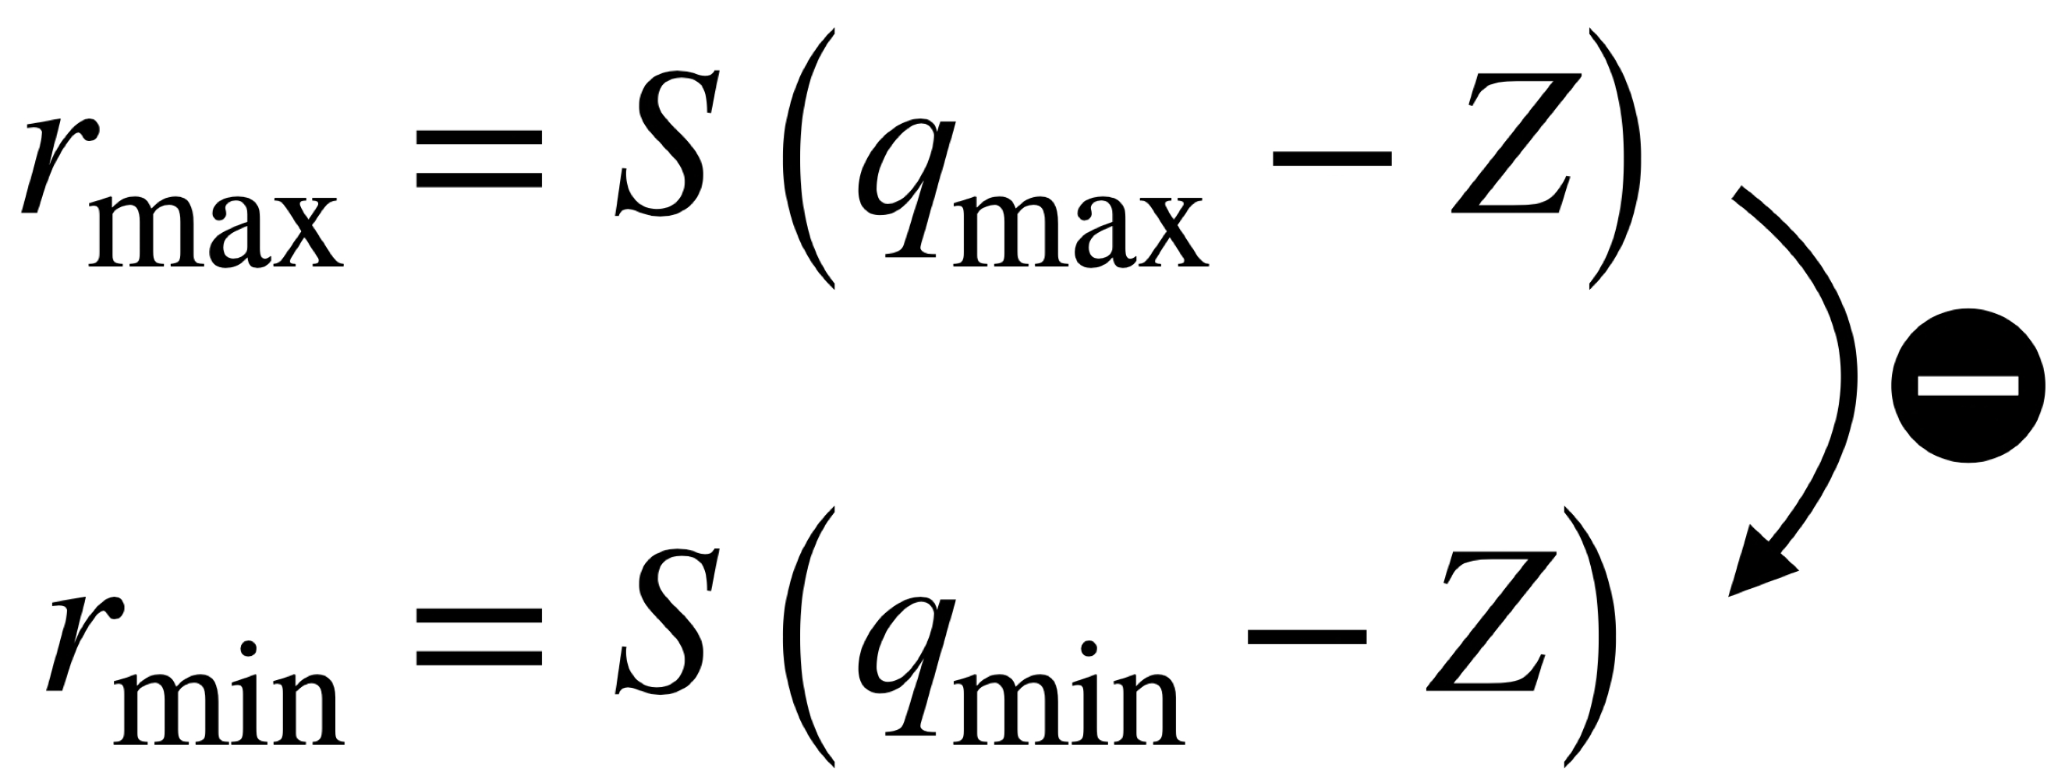
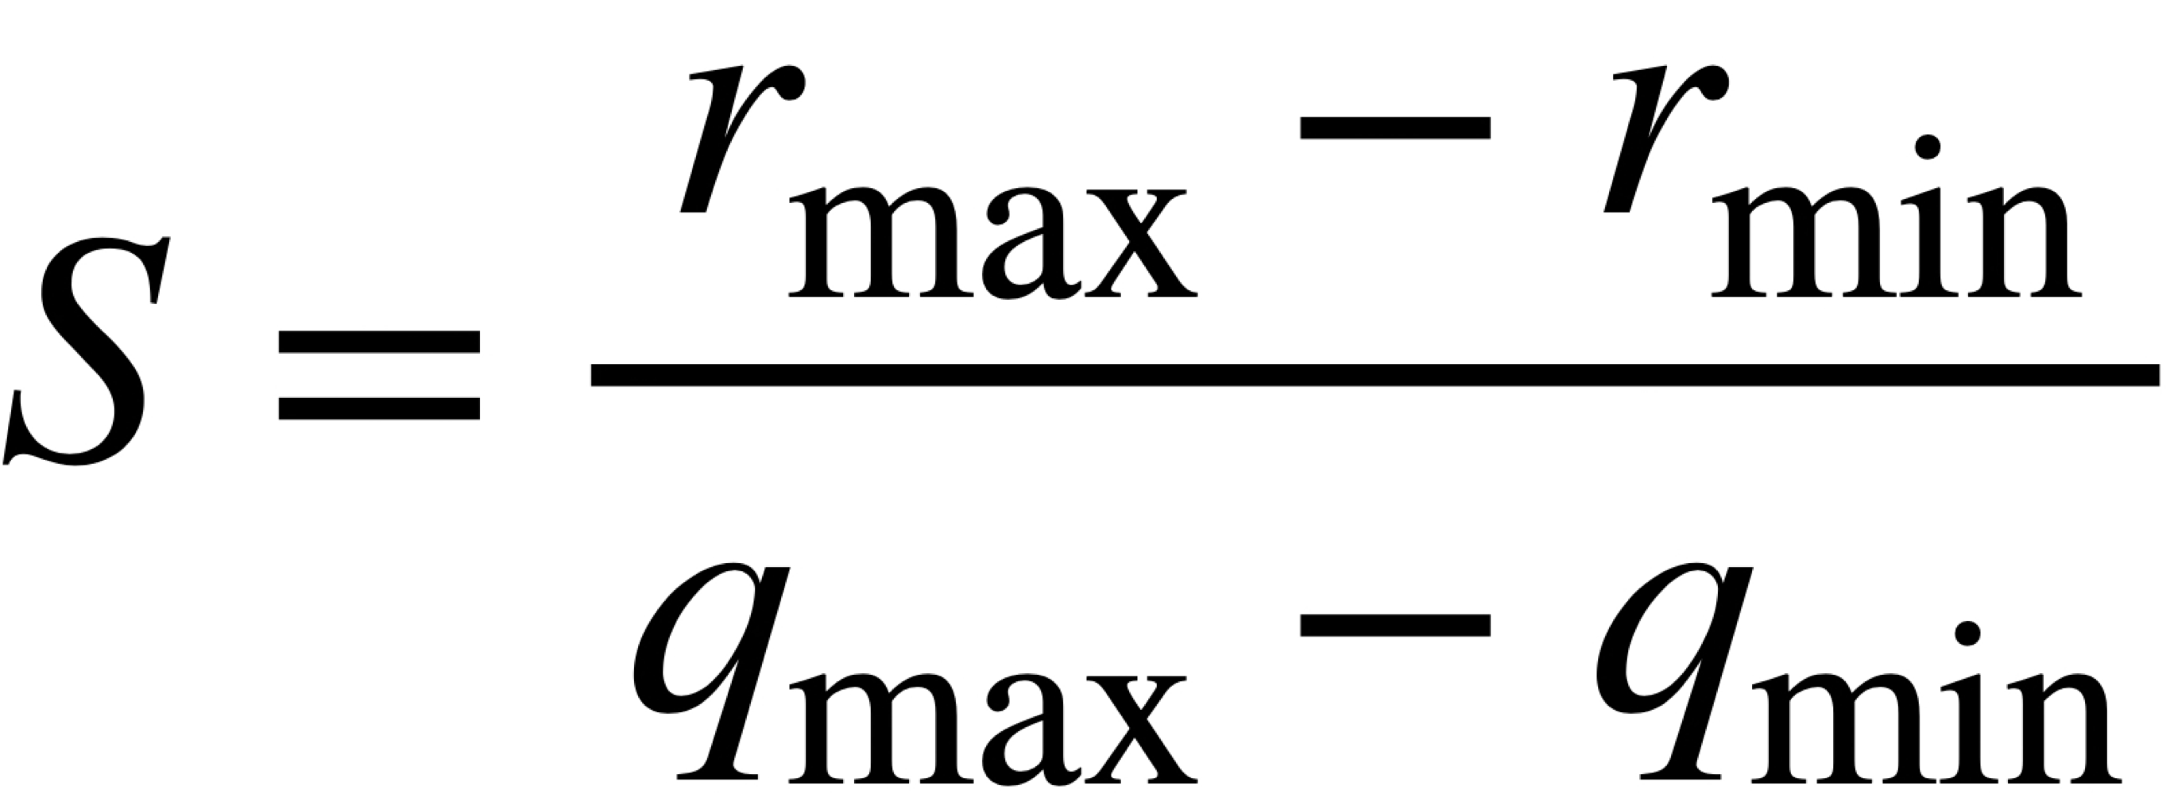
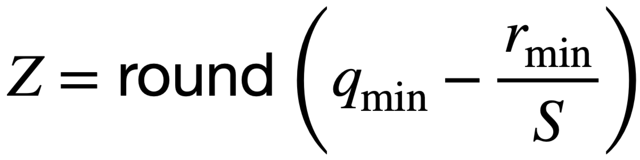
Quantization
Linear quantization
An affine mapping of integers to real floating-point numbers
Known N-bit representation, we calculate Z and S based on r_{min} , r_{max} and q_{min} , q_{max}
=>
(=255)

Slide 4
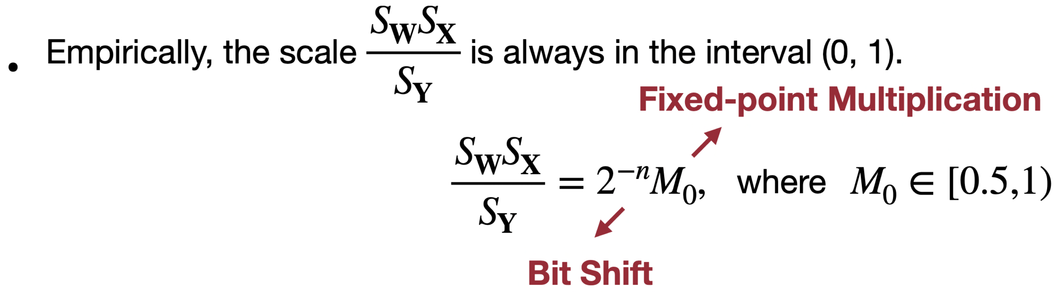


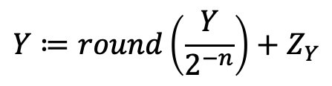

Quantization
Quantized matrix multiplication (QLinearMul)
Y = WX + B
$$S_{Y}\left(Y_{q}−Z_{Y}\right)=S_{W}\left(W_{q}−Z_{W}\right)×S_{X}\left(X_{q}−Z_{X}\right) +S_{W}S_{X}B_{q}$$
$$→Y_{q}=Z_{Y}+\frac{S_{W}S_{X}}{S_{Y}} \left[\left(W_{q}−Z_{W}\right)×\left(X_{q}−Z_{X}\right) +B_{q}\right]$$
$$Y≔\frac{(\left(X_{q}−Z_{i}\right)\left(W_{q}−Z_{W}\right)+B_{q})∗M_{0}}{2^{31}}$$
$$Y≔round\left(\frac{Y}{2^{−n}}\right)+Z_{Y}$$

Slide 5
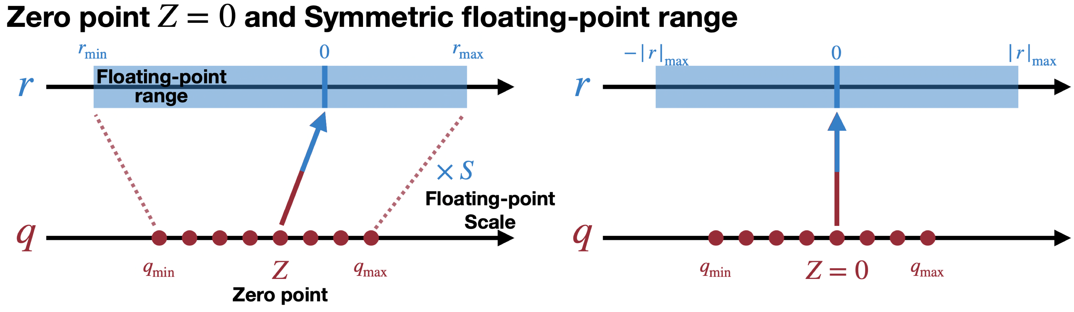
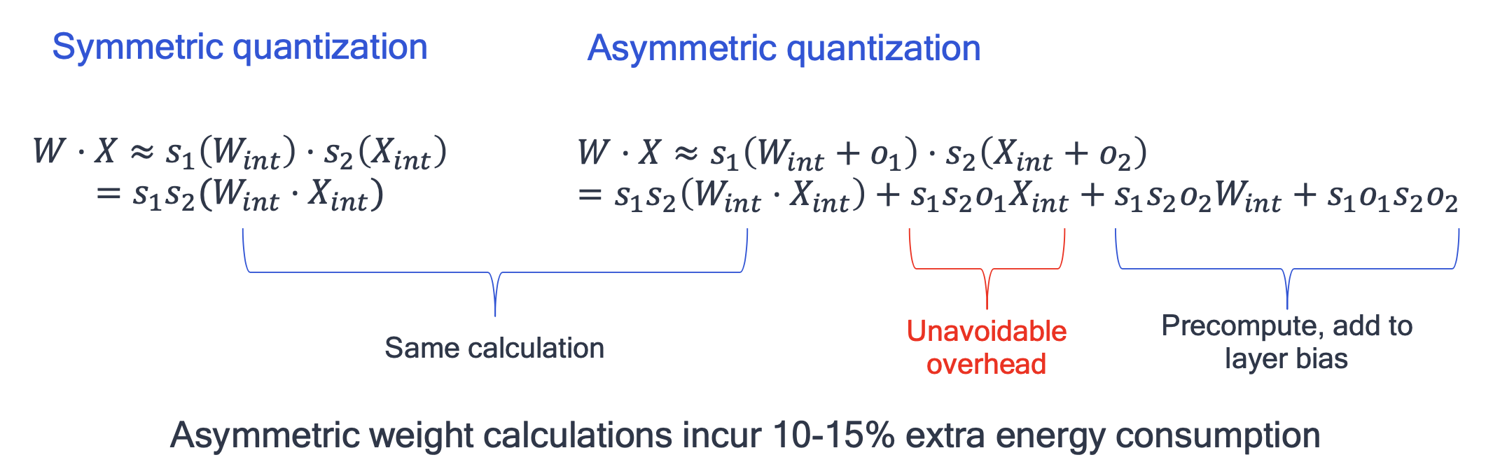
Quantization
Asymmetric quantization vs. symmetric quantization
Common quantization techniques prefer symmetric quantization

Slide 6

Quantization
Quantized convolution (QLinearConv)
Y = Conv(W, X) + B
$$→Y_{q}=Z_{Y}+\frac{S_{W}S_{X}}{S_{Y}} \left[conv(\left(W_{q}−Z_{W}\right),\left(X_{q}−Z_{X}\right)) +B_{q}\right]$$
$$Y≔\frac{(\left(X_{q}−Z_{i}\right)\left(W_{q}−Z_{W}\right)+B_{q})∗M_{0}}{2^{31}}$$
$$Y≔round\left(\frac{Y}{2^{−n}}\right)+Z_{Y}$$

Slide 7
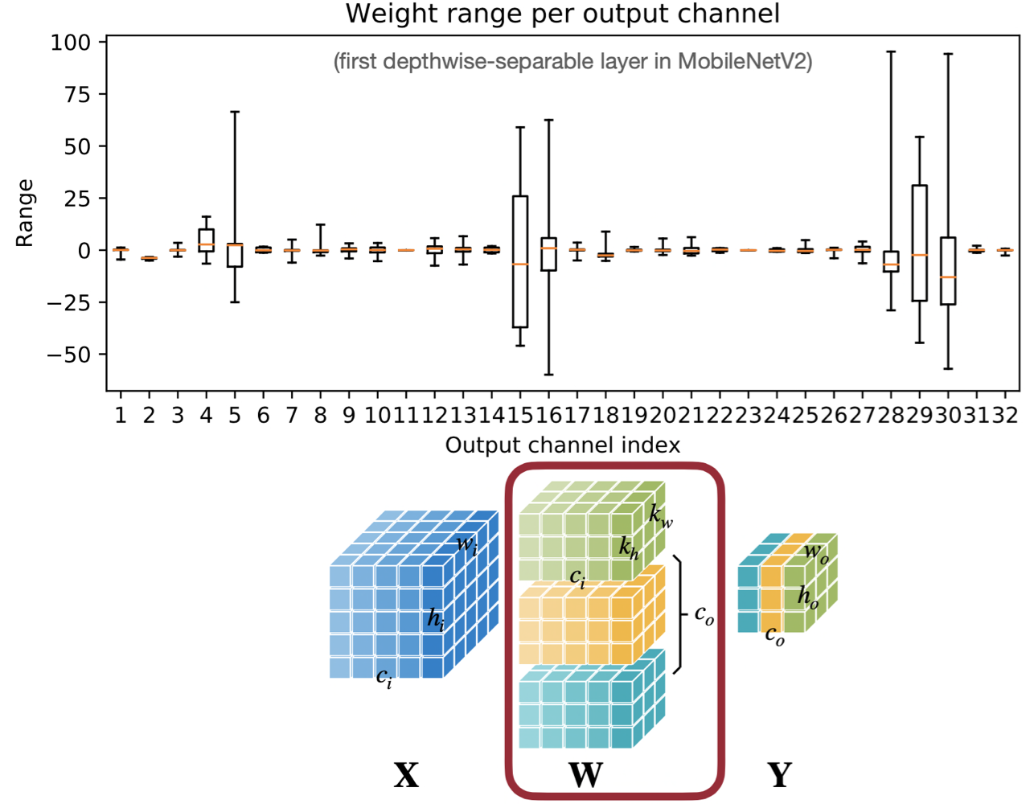
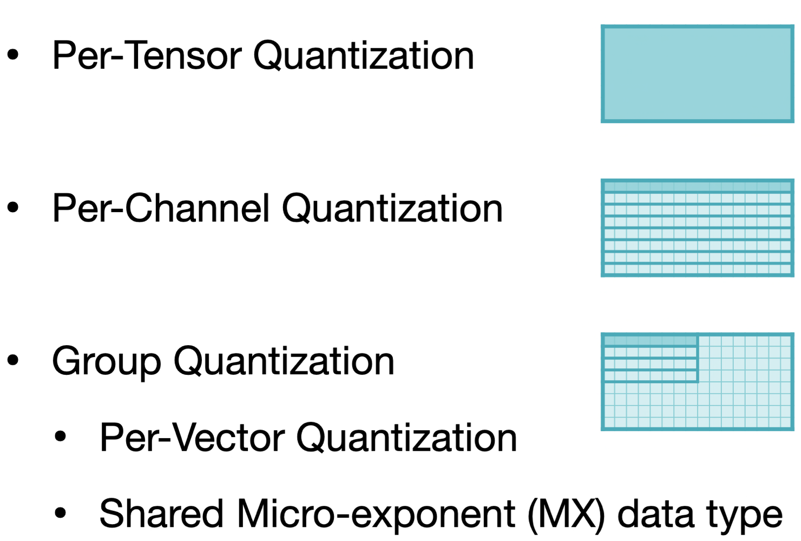
Quantization
per-channel and rer-tensor quantization

Slide 8
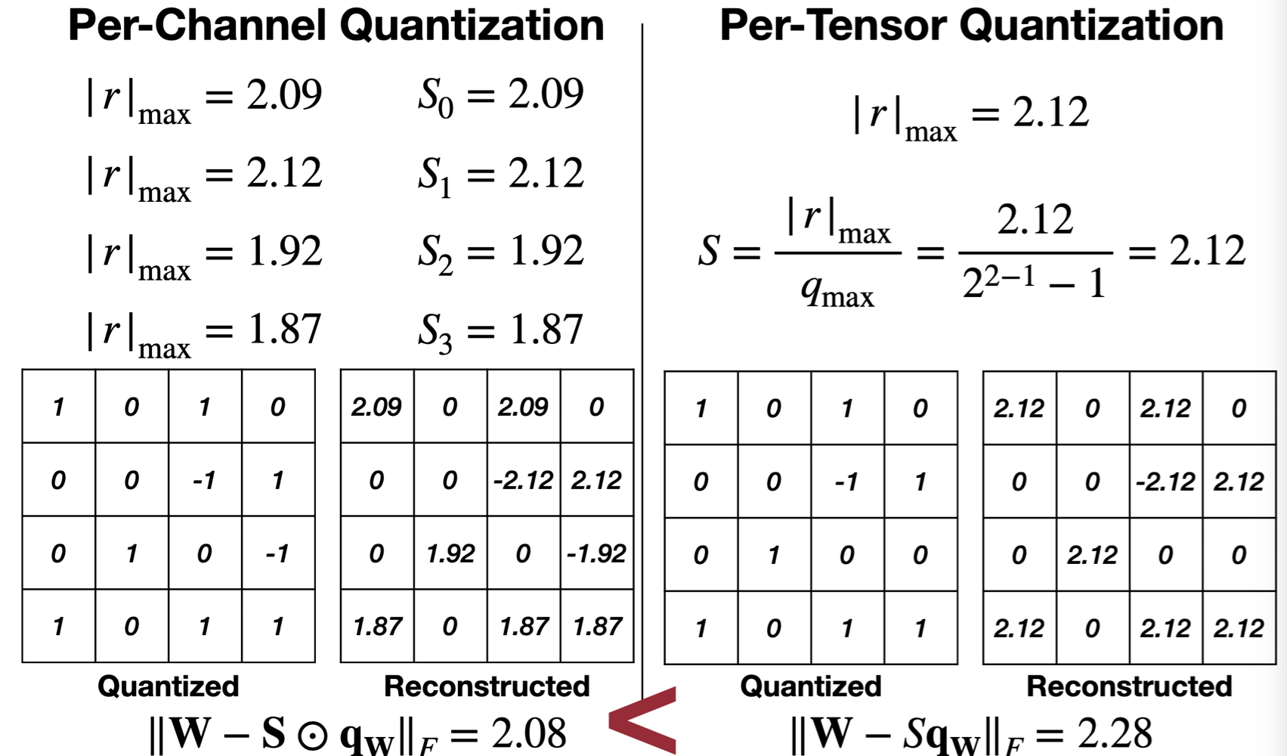
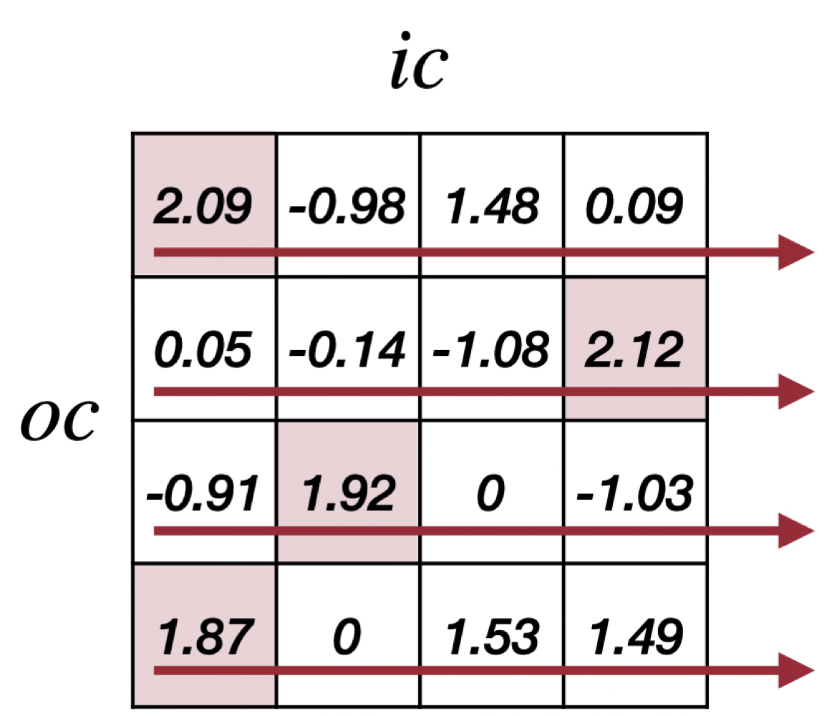
Quantization
per-channel and rer-tensor quantization

